Slide 1
Field Effect Transistors

Slide 2
Transistor problems
Power density increased
Device variability
Reliability
Complexity
Leakage
Power dissipation limits device density
Transistor will operate near ultimate limits of size and quality – eventually, no transistor can be fundamentally better
◄

Slide 3
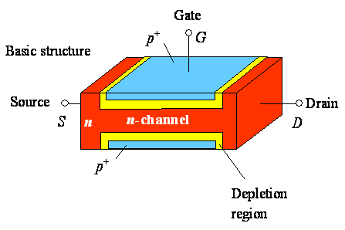
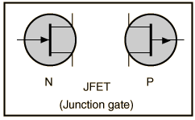
Junction FETs (JFETs)
A piece of semiconductor material which constitutes a channel
Conducting semiconductor channel between two ohmic contacts – source & drain
The Symbol

Slide 4
n type bar acts as a simple semiconductor resistor
Electrons flow from Source to drain if an electric field is applied between them
Only one carrier – electrons (for n-channel) or holes (for p channel) - unipolar
Depletion region exists for p-n junctions
Due to depletion region, the conduction portion of channel constricts
Channel thickness is dependent on both V_{DS} and V_{GS}

Slide 5
Electrons flow from source to Drain
Current I_{D} flows through channel
For a fixed V_{DS}, I_{D} is also dependent on V_{GS} as it increases or decreases the reverse bias
Mechanism of current is the effect of field produced by V_{DS} and V_{GS} (FIELD EFFECT TRANSISTOR)
I_{D}
V_{GS}
V_{DS}

Slide 6
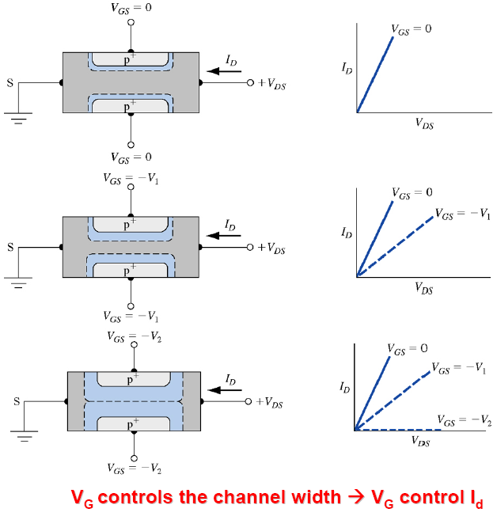
I-V characteristics
More V_{GS} (more –ve) implies
- More reverse bias
- More depletion region
- Less channel width
- Less current I_{D}

Slide 7
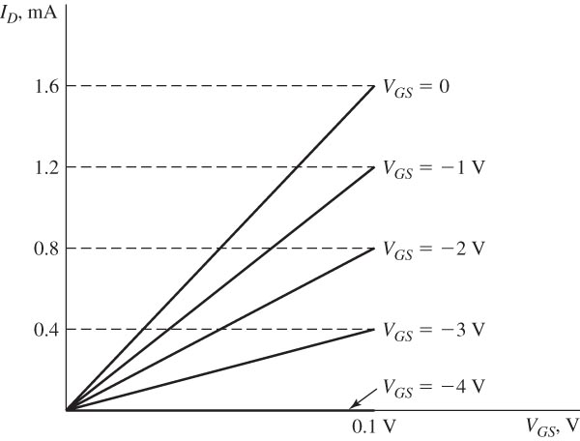
Characteristics in linear portion of the ohmic region.
V_{DS}
Current I_{D} flows through channel following Ohm’s law

Slide 8
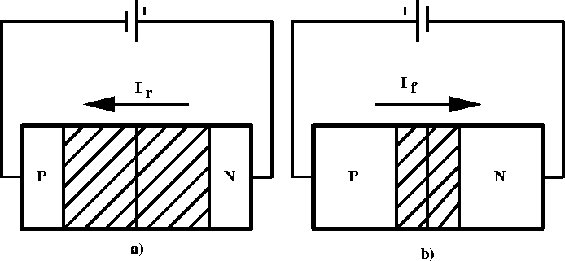
Junction FETs (JFETs)
Length of Depletion region depends on the reverse bias voltage
Length of Depletion region depends on the voltage difference between channel and gate
The voltage at channel is dependent on position , as ohmic drop varies along the channel
Thus the constriction of conduction channel is not uniform

Slide 9
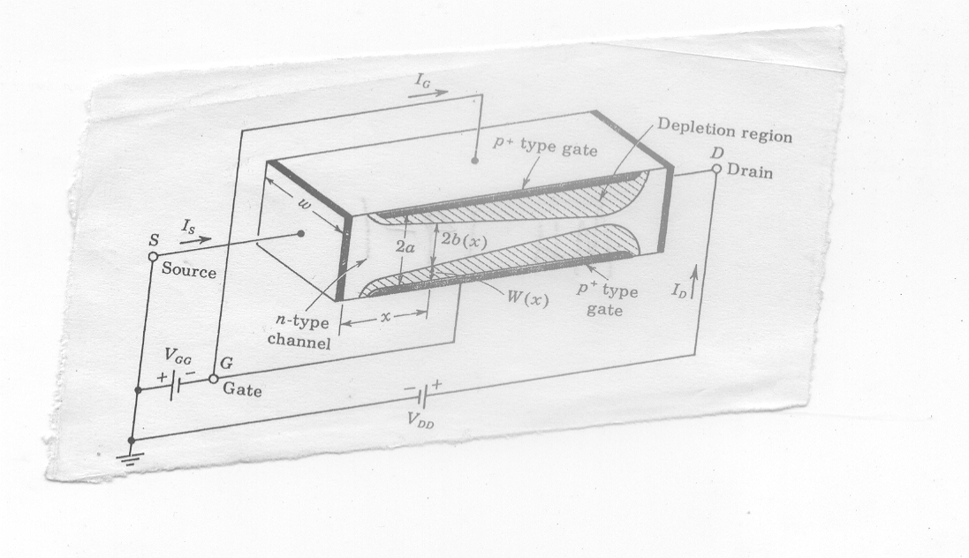
The structure of a n-Channel FET
The constriction is more pronounced at distance farther from the source
The constriction is dependent on the current (which is dependent on both V_{GS} and V_{DS})

Slide 10
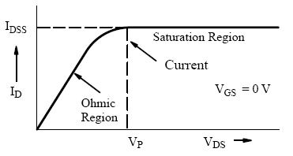
The structure of a n-Channel FET
I_{D}
V_{GS}
V_{DS}
For a fixed V_{GS}, if increase V_{DS} more and more, I_{D} will increase, - and channel will constrict more and more
Eventually I_{D} is reached to such a level (I_{DSS}) such that the channel is pinched off
At this point I_{D} begins to level off and approach a constant value
pinch-off voltage, V_{P} , which is the value of V_{DS} at which the maximum I_{DSS} flows
Note: channel never completely closes as that reduces I_{D} to zero

Slide 11
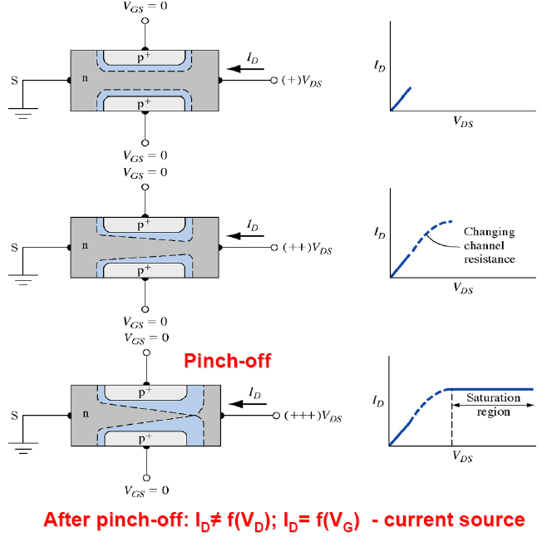
I-V characteristics

Slide 12
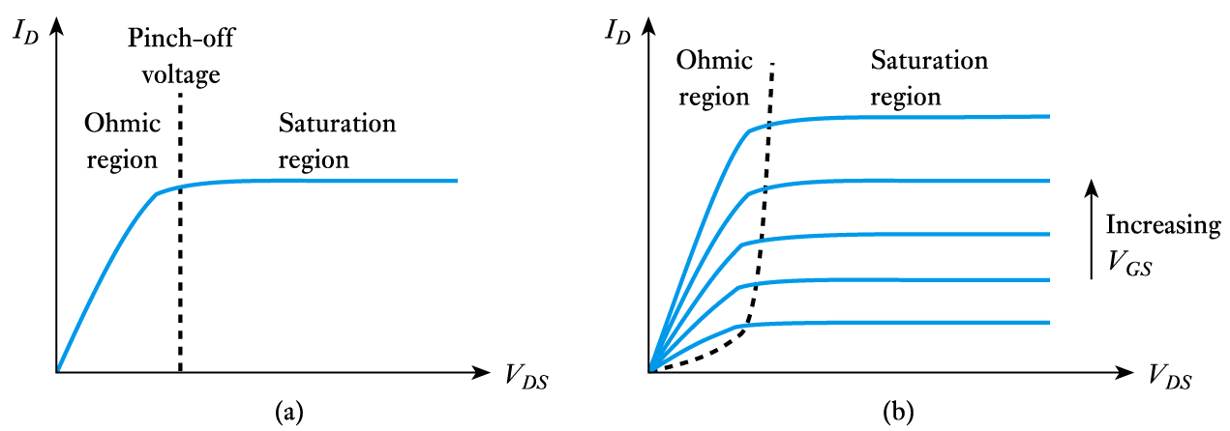
FET output characteristics

Slide 13
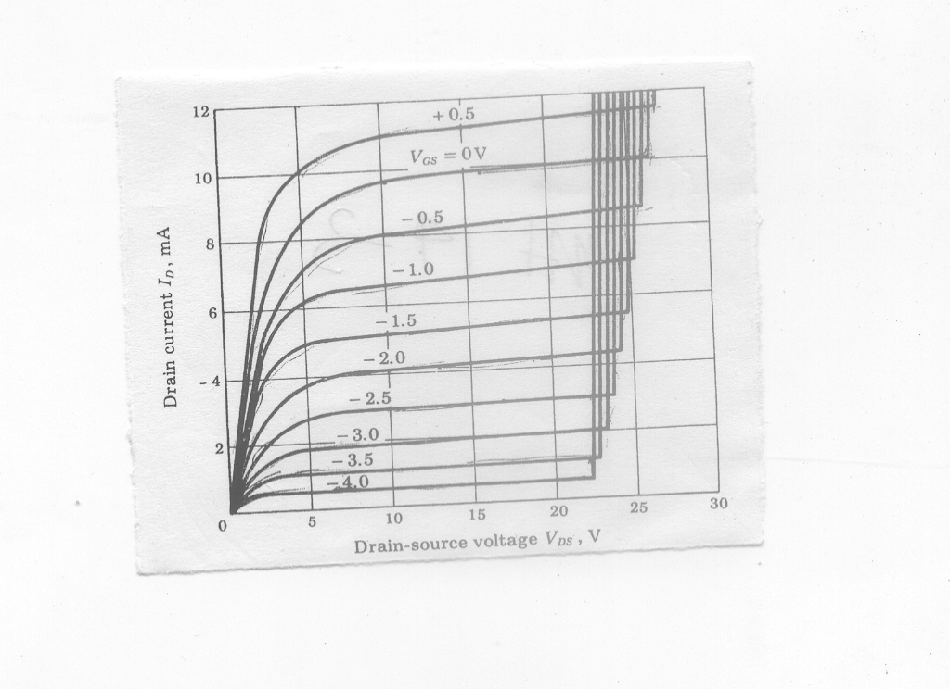
Increasing more and more reverse bias (V_{DS} ) causes the junctions to breakdown
If V_{GS} is more negative, the breakdown occurs at early V_{DS}

Slide 14
More practical n-channel JFET
Difficult in diffusing impurities into both sides of a semiconductor
(a)
Single-ended-geometry junction FET
Diffusion is from one side only
N-type channel is epitaxially grown in p-type substrate

Slide 15
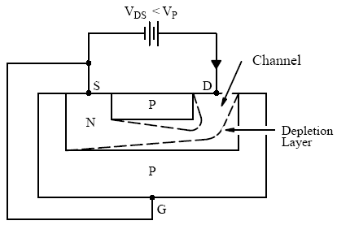
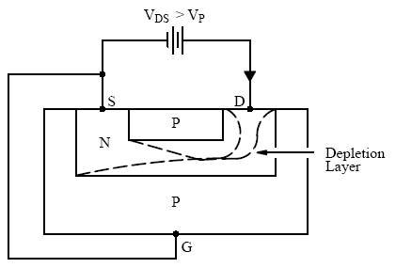
Depletion layer thickness is changing with V_{DS}

Slide 16
Bipolar Junction Transistor versus Field Effect Transistor
FET is unipolar. – there is only majority carrier. BJT is bipolar (there are both majority and minority carrier)
No offset voltage at zero drain current
High input resistance
Has thermal stability
Less noisy
Relatively immune to radiation
Simpler to fabricate and takes less space in integrated form

Slide 17
Metal Oxide Semiconductor Field-Effect Transistor

Slide 18
MOSFET: Metal Oxide Semiconductor Field-Effect Transistor
n channel MOSFET
In lightly doped p-type substrate, two highly doped n regions (source and drain) are diffused
Insulator is grown over surface and holes are cut into it to have contact with source and drain
For Si substrate, SiO₂ is used as the Insulator

Slide 19
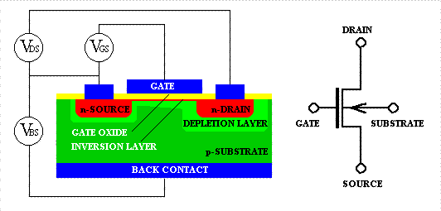
Metal-Oxide-Semiconductor Field-Effect Transistor (MOSFET)
n-channel

Slide 20
(+)
MOSFET operation
Substrate: Grounded
Gate : + ve voltage
+ + + + + + + + + + + + +
_ _ _ _ _ _ _ _ _ _
+ + + + + + + + + + + +
- - - - - - - - - - - -
An electric field is directed perpendicularly through oxide
Negative charge is induced on semiconductor
A channel is formed between drain and source
Width of channel depends on gate voltage
Induced channel

Slide 21
Electrons may flow through Channel

Slide 22
Basic Operation
1) Source and substrate grounded (zero voltage)
2) (+) voltage on the gate
Attracts e⁻s to Si/SiO2 interface; forms channel
3) (+) voltage on the drain
e⁻s in the channel drift from source to drain
current flows from drain to source

Slide 23
MOSFET
Metal-oxide-semiconductor field-effect transistor
G = gate, D = drain, S = source, B = body (substrate)

Slide 24
N enhance FET at Pinchoff

Slide 25
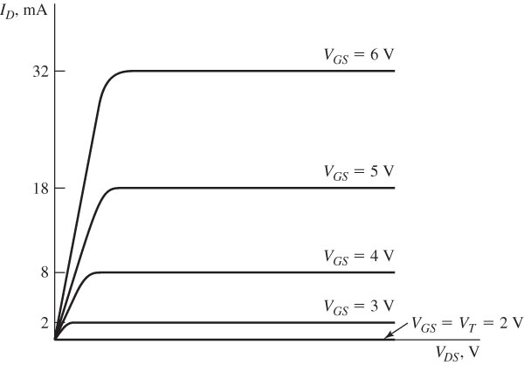
Drain characteristics for an ideal representative N-channel enhancement-mode MOSFET.

Slide 26
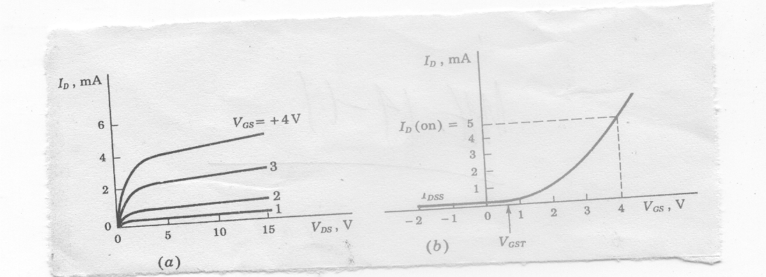
(a) I_{D} versus V_{DS} (b) I_{D} versus V_{GS} for a fixed V_{DS}
As V_{GS} is made positive I_{D} increases slowly at first and then much rapidly
I_{D} reaches significant value (some predefined small ) at threshold voltage

Slide 27
N channel Depletion mode FET ON – No gate bias
A channel is diffused between source and Drain

Slide 28
(- ve)
Channel Depletion with application of
negative voltage
- - - - - - - - - - - - - - -
+ + + + + + + + + + + + + + + +
- - - - - - - - - - - - - - - - - - - - - - - - - -
Induced +ve charge makes the channel less conductive
Causes effective depletion of majority carriers
Analogous to JFET characteristics
+ + + + + + + + + + + + + + +
+ + + + + + + + + + +
+ + + + +

Slide 29
N channel Depletion mode FET off

Slide 30
nMOS Cutoff
No channel
I_{ds} ≈ 0

Slide 31
nMOS Linear
Channel forms
Current flows from d to s
e⁻ from s to d
I_{ds} increases with V_{ds}
Similar to linear resistor

Slide 32
nMOS Saturation
Channel pinches off
I_{ds} independent of V_{ds}
We say current saturates
Similar to current source

Slide 33
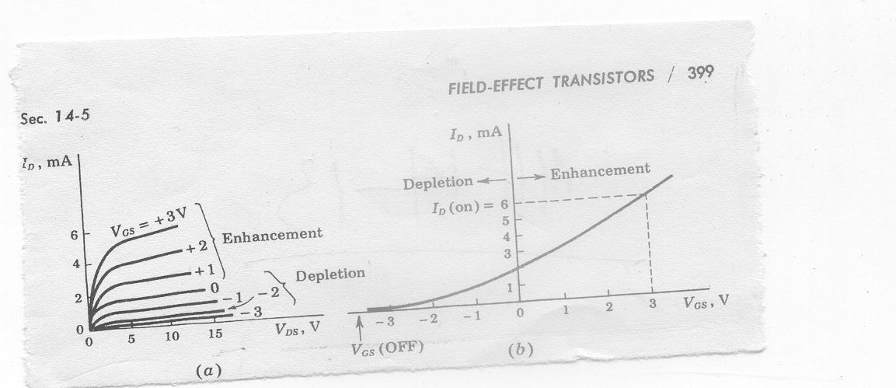
N channel Depletion mode MOSFET
(a) I_{D} versus V_{DS} (b) I_{D} versus V_{GS} for a fixed V_{DS}
May be used for both enhancement and depletion mode
Lower threshold voltage than enhancement type

Slide 34
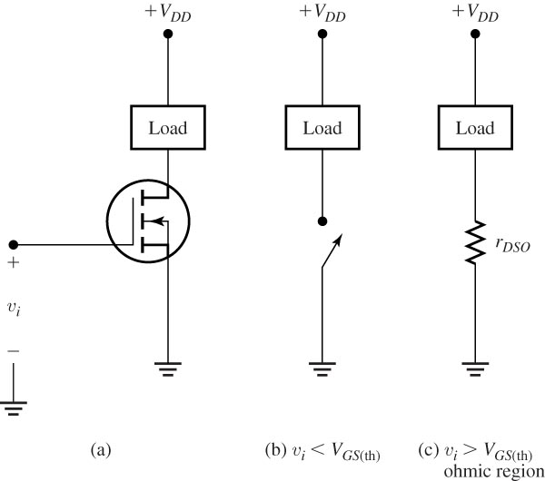
Switch using an N-channel enhancement-mode MOSFET.

Slide 35
Comparison between p- with n-channel FET
p-channel is easier to fabricate
n-channel is faster as the mobility of electrons is 3 times greater than the mobility of holes
n-channel takes less space

Slide 36
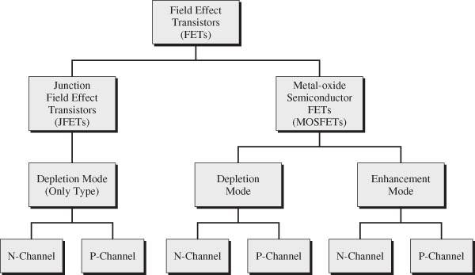
Classification scheme for field effect transistors

